Slide 1
resolving differences
Jun 12th, 2023

Slide 2
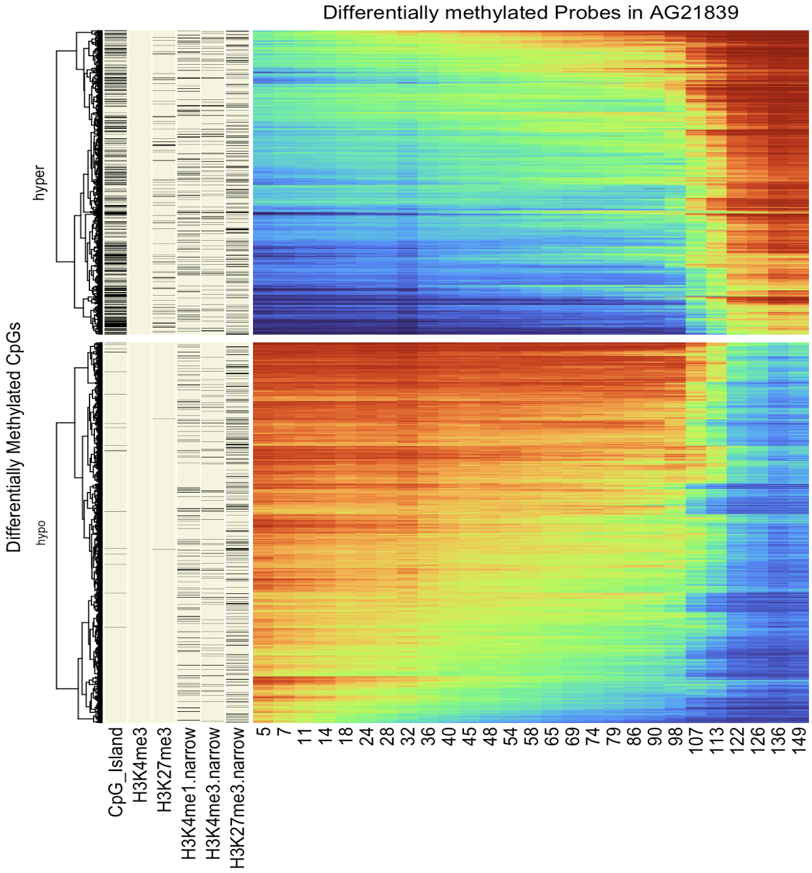
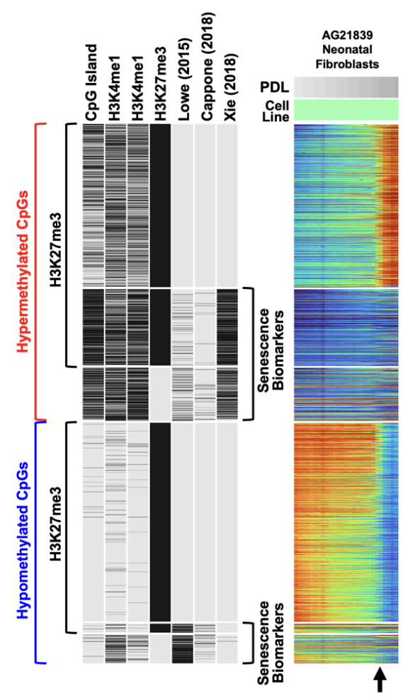

Slide 3
Q1. why do we have differing numbers of diff. methylated probes?
Jamie set threshold as 0.25 and get 4400 probes.
Toshi set threshold 0.5 and gets 14,000 probes
Doesn’t makes sense.

Slide 4
mistake in the script
Select the last 3 columns and compute the row-wise average
last_three <- df[,ncol(df)-2:ncol(df)]

Slide 5
mistake in the script
Select the last 3 columns and compute the row-wise average
last_three <- df[,ncol(df)-2:ncol(df)]
> # Compare column names
> colnames(df[, ncol(df)-2:ncol(df)])
[1] "X203026840107_R05C01" "X203026840107_R04C01" "X203026840107_R03C01" "X203026840107_R02C01"
[5] "X203026840107_R01C01" "X202253620093_R04C01" "X202253620093_R03C01" "X202253620093_R02C01"
[9] "X202253620093_R01C01" "X202253620085_R08C01" "X202253620085_R07C01" "X202253620085_R06C01"
[13] "X202253620085_R05C01" "X202253620085_R04C01" "X202253620085_R03C01" "X202253620085_R02C01"
[17] "X202253620085_R01C01" "X202253620011_R08C01" "X202253620011_R07C01" "X202253620011_R06C01"
[21] "X202253620011_R05C01" "X202253620011_R04C01" "X202253620011_R03C01" "X202253620011_R02C01"
[25] "X202253620011_R01C01"
> colnames(df[, 25:27])
[1] "X203026840107_R05C01" "X203026840107_R06C01" "X203026840107_R07C01"

Slide 6
mistake in the script
Select the last 3 columns and compute the row-wise average
last_three <- df[,ncol(df)-2:ncol(df)]
> # Compare column names
> colnames(df[, ncol(df)-2:ncol(df)])
[1] "X203026840107_R05C01" "X203026840107_R04C01" "X203026840107_R03C01" "X203026840107_R02C01"
[5] "X203026840107_R01C01" "X202253620093_R04C01" "X202253620093_R03C01" "X202253620093_R02C01"
[9] "X202253620093_R01C01" "X202253620085_R08C01" "X202253620085_R07C01" "X202253620085_R06C01"
[13] "X202253620085_R05C01" "X202253620085_R04C01" "X202253620085_R03C01" "X202253620085_R02C01"
[17] "X202253620085_R01C01" "X202253620011_R08C01" "X202253620011_R07C01" "X202253620011_R06C01"
[21] "X202253620011_R05C01" "X202253620011_R04C01" "X202253620011_R03C01" "X202253620011_R02C01"
[25] "X202253620011_R01C01"
> colnames(df[, 25:27])
[1] "X203026840107_R05C01" "X203026840107_R06C01" "X203026840107_R07C01"

Slide 7
mistake in the script
Select the last 3 columns and compute the row-wise average
last_three <- df[,ncol(df)-2:ncol(df)]
last_three <- df(df[, (ncol(df)-2):ncol(df)]) # fixed
> # Compare column names
> colnames(df[, (ncol(df)-2):ncol(df)])
[1] "X203026840107_R05C01" "X203026840107_R06C01" "X203026840107_R07C01"
> colnames(df[, 25:27])
[1] "X203026840107_R05C01" "X203026840107_R06C01" "X203026840107_R07C01”
YAY THEY MATCH!

Slide 8
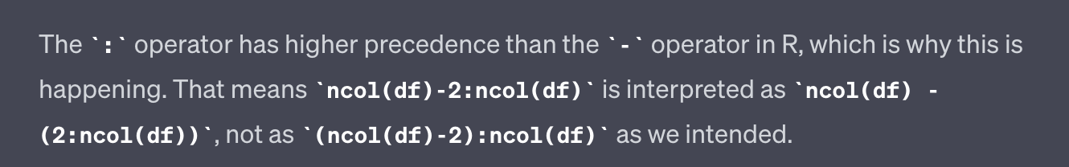

lesson learnt; (schooled by GPT4)
conclusion : I’ve been averaging the entire dataset to get differetially methylated probes, resulting in very little number of probes that passed the threshold.

Slide 9
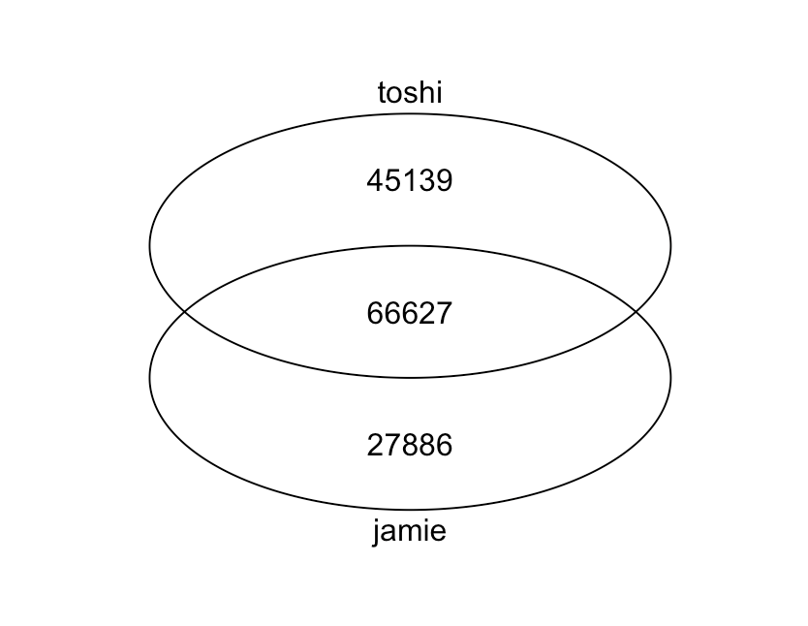
Q2. why do we have different peaks for H3K27me3?
venn(toshi, jamie)
I don’t have qvalues on https://egg2.wustl.edu/roadmap/web_portal/processed_data.html#ChipSeq_DNaseSeq%5C

Slide 10
Q3. why is it gradual?
Toshi has hclust off.
I put hclust on.

Slide 11
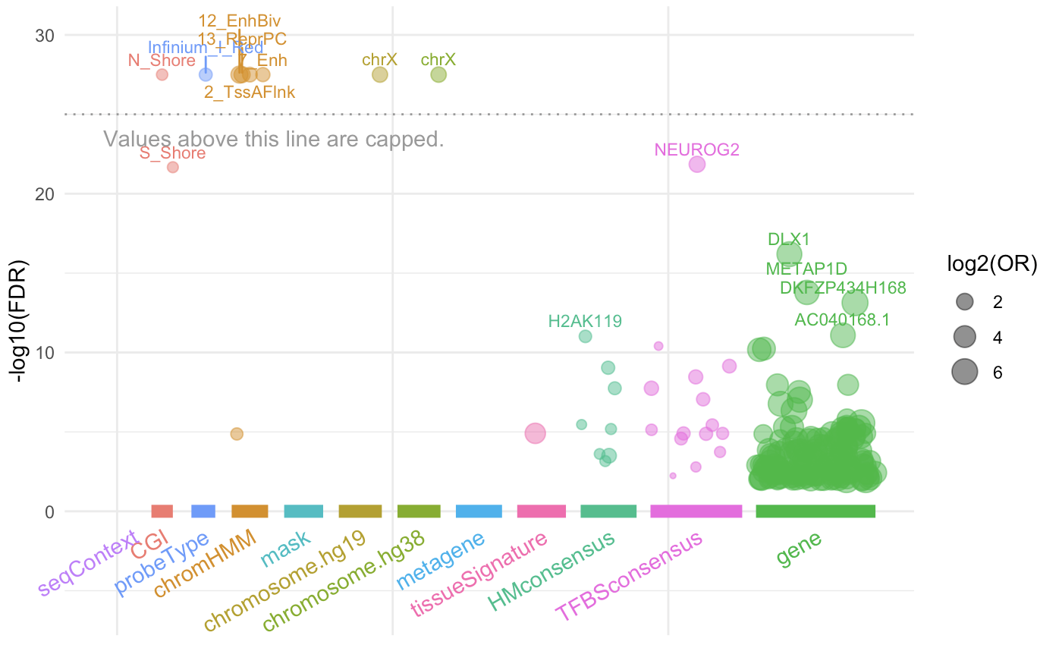
4352 hypermethylated probes (without H3K27me3 marker filter)

Slide 12
EPIC.2 heatmap
1. import idats (green,red)
2. import meta.file; samplesheet (requires EPIC_ID annotation)
3. Using sesame to generate beta-value mtx.
4. pre-format beta-value mtx
array->df, remove NAs, filter for condition, change colnames etc.
5. identify Diff. meth. probes (i.e. early vs. late w/ threshold 0.5)
run enrichment (”knowyourCG”)
6. visualize heatmap (vertical concat Hypo + Hyper)
7. add manifest (row_annotation)

Slide 13
Epigenetic conf; MOET
Mechanisms of Eukaryotic Transcription
https://meetings.cshl.edu/meetings.aspx?meet=MOET&year=23

Slide 14
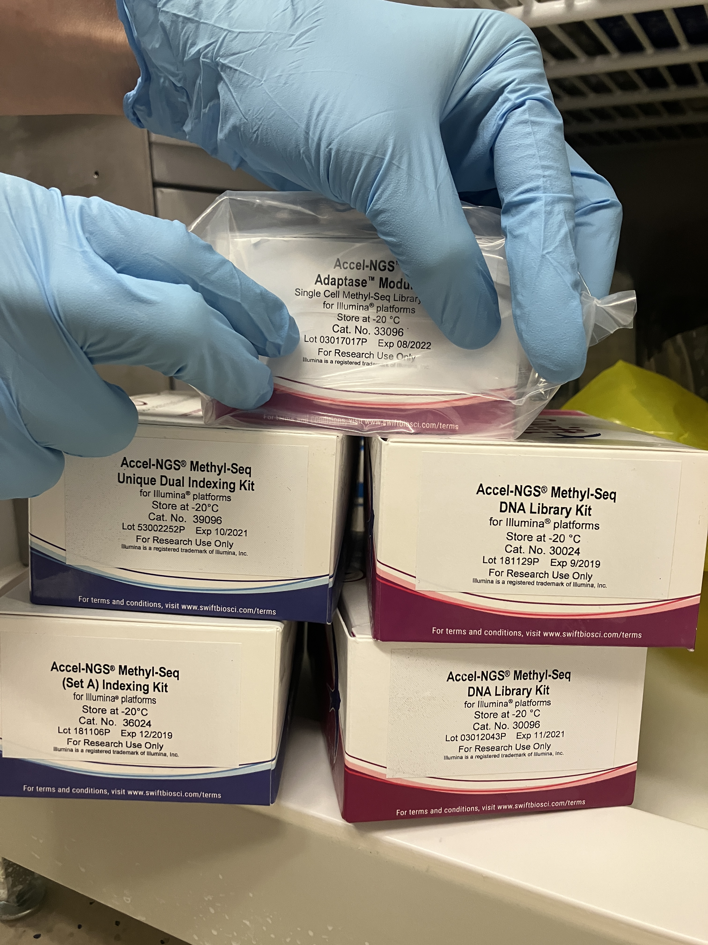
NGS-Methyl-Seq DNA lib.
Kit name | expr. date
Accel-NGS Methyl-Seq Dual Indexing kit | Oct 2021
Accel-NGS Methyl-Seq (Set A) indexing kit | Dec 2019
Accel-NGS Methyl-Seq DNA lib. kit 1 | Sept 2019
Accel-NGS Methyl-Seq DNA lib. kit 2 | Nov 2021
Accel-NGS Methyl-Seq Adaptase | Aug 2022
David from Shen Lab : “we don’t have any either”

Slide 15
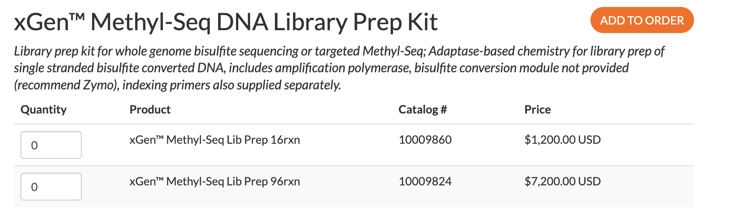
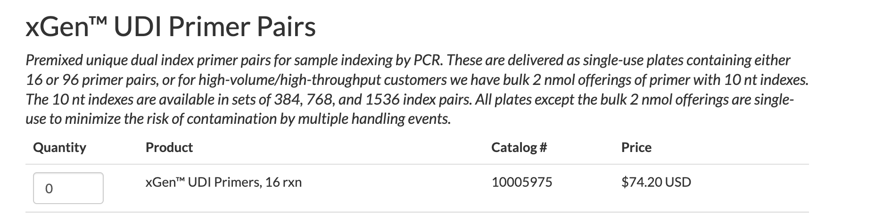
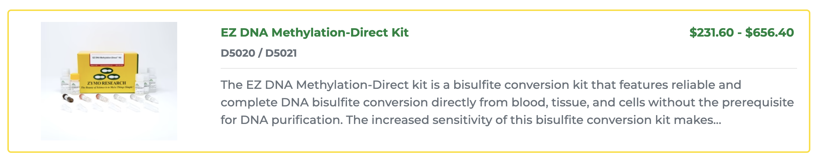
Kit pricing
we already have the zymo kit,
so in total $1,275.
Notes:
https://www.idtdna.com/pages/products/next-generation-sequencing/workflow/xgen-ngs-library-preparation/methyl-seq-dna-library-kit?utm_source=google&utm_medium=cpc&utm_campaign=00587_1c_03&utm_content=search&gclid=CjwKCAjwp6CkBhB_EiwAlQVyxXQOMYl2SrF_Vr8t-9VcCx-PZyCLgUfzEcc5yiGwctNuv7htK9dWChoC5SwQAvD_BwE

Slide 16
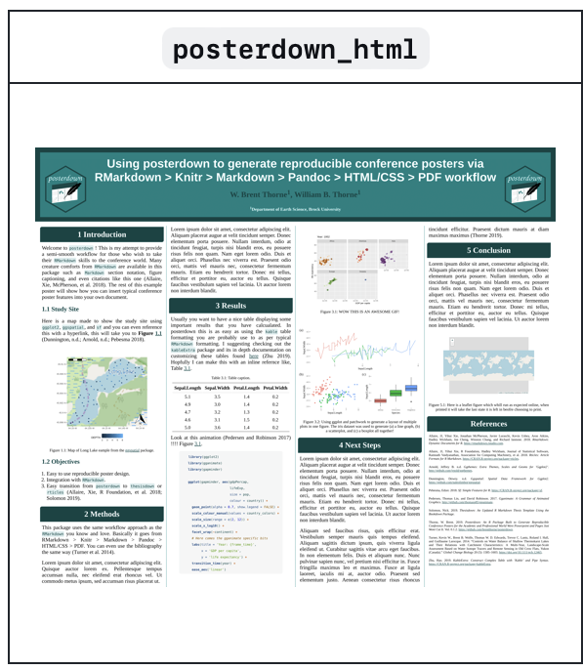
VAIGS Poster for new students
ideas?
posterdown
1. hypomethylation – Jamie’s project
2. hypermethylation – Nathan’s project;

